Slide 1
Article 13(b) and the issue of asylum in abduction proceedings James Netto
www.iflg.uk.com
James Netto

Slide 2
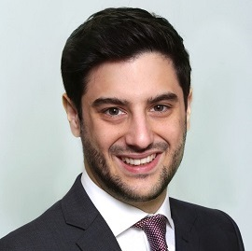
Speaker
James Netto
‘James Netto is an all-round astonishingly good lawyer. He is an absolute star. He has flair, intelligence, wisdom and solid determination. There is no available avenue that he will not explore in the pursuit of the best result for his client.’
The Legal 500 2020
"The iFLG team combines an unparalleled knowledge of international family law with excellent client skills. The team provides a first-class service. “
The Legal 500 2021
Leading Firm
www.iflg.uk.com
David Hodson

Slide 3
A word on Article 13(b)
The most commonly pleaded defence, yet (historically) the least likely to be successful; are the tides turning? Law as set out in Uhd v McKay [2019] EWHC 1239 Fam (referring to Re E)
The court should assume the risk of harm at its highest and then, if that risk meets the test in Art 13(b), go on to consider whether protective measures sufficient to mitigate harm can be identified. BUT: not an exercise that excludes consideration of relevant evidence before the court – for example, domestic judgments, presentation of evidence etc.,
First, the court will look very critically at an assertion of intense anxieties not based upon objective risk. Second, the court will need to consider any evidence demonstrating the extent to which there will, objectively, be good cause for the respondent to be anxious on return, which evidence will remain relevant to the court's assessment of the respondent's mental state if the child is returned. Third, where the court considers that the anxieties of a respondent about a return with the child are not based upon objective risk to the respondent but are nevertheless of such intensity as to be likely, in the event of a return, to destabilise the respondent's parenting of the child to a point where the child's situation would become intolerable, the court will still ask if those anxieties can be dispelled, i.e. whether protective measures sufficient to mitigate harm can be identified
www.iflg.uk.com
James Netto

Slide 4
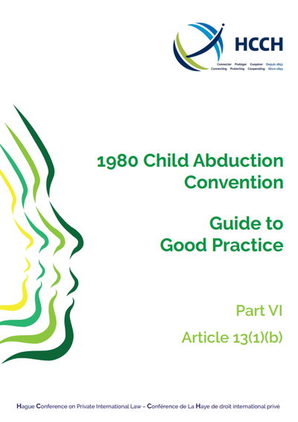
Article 13(b) – Guide to Good Practice
Art 13(b) cases include:
Domestic violence against the child/parent
Economic or developmental disadvantages
Risks in state of habitual residence/child’s health
Risk of separation
Immigration issues
Criminal issues
Separation from siblings
www.iflg.uk.com
James Netto

Slide 5
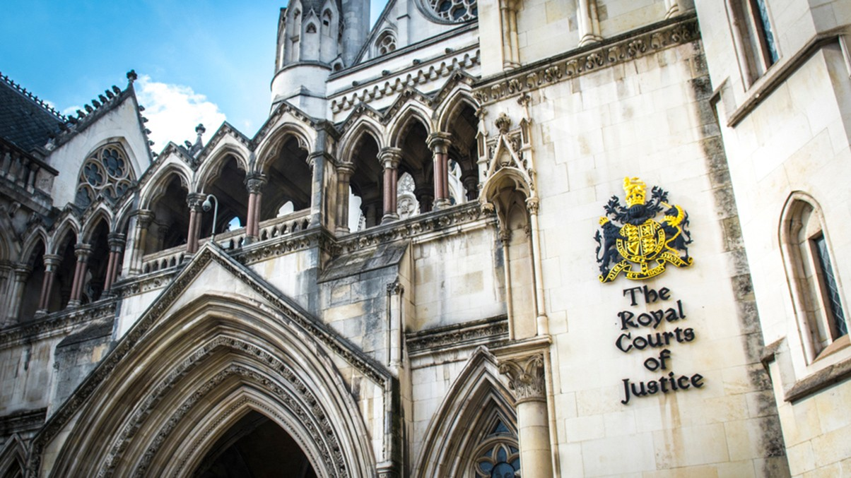
Article 13(b) – Undertakings
Goodbye, BIIA and Art 11(4) – but is it a big loss?
See Art 11 1996 HC, in lieu of Art 11(4) BIIA; protective measures include all steps that can be taken, including housing, financial support, as well as more traditional measures such as non-molestation injunctions (Re C [2018] EWCA Civ 2834)
AB v CD (Abduction; Undertakings) [2021] EWHC 665 (Fam)
Undertakings not enforceable as a matter of domestic law
Return ordered notwithstanding
www.iflg.uk.com
James Netto

Slide 6
Article 13(b) – mental health
Perhaps the trickiest of all Article 13(b) cases!
Respondent’s (or child’s) mental health issues as grounds for non-return?
W (A Child) [2018] EWCA Civ 1904 – even post return order, judgment can be set aside - mother's psychiatric health had "fundamentally changed" and that she was “psychologically overwhelmed by the circumstances”
A (Child Abduction Article 13b) [2021] EWCA Civ 328 – return order made; however, based on the further evidence concerning the mother's mental health and family support, the Court of Appeal did not think that the Judge's order could stand
PTSD? Depression? Intertwining issues of domestic violence?
www.iflg.uk.com
James Netto

Slide 7
Article 13(b) – mental health: Top tips
If for an applicant:
Flag issues at early available opportunity to ensure a final hearing is not derailed
Did the respondent have known mental health issues before abducting?
What protective measures can be set up before returning? Make them watertight!
Can a court order be put in place in country of origin?
Return proceedings in country of origin?
If for a respondent:
Obtain psychiatrist with relevant cultural background and/or experience of Hague cases
Obtain medical records from country of origin
Monitor constantly – prospect of set aside?
www.iflg.uk.com
James Netto

Slide 8
Re G – Asylum as a bar to return
G is an only child of divorced parents. Until February 2020, her parents lived near to each other in South Africa. However, after telling friends that she was lesbian, G’s mother began to experience persecution from her family in South Africa. As a result, she fled to England with G and made an application for asylum. Upon discovering that G had been taken to England, G’s father made an application for her return under the 1980 Hague Convention
At first instance, Lieven J held that the father’s application for a return order should be stayed pending the determination of G’s mother’s asylum claim. The Court of Appeal considered that, in the circumstances, the High Court was not barred from determining the father’s application for a return order, nor was it barred from making such an order
www.iflg.uk.com
James Netto

Slide 9
Re G – Asylum as a bar to return
An asylum claim is an absolute bar to enforcement of a Hague return order, until the claim has been either decided by the Home Secretary. This does not prevent the determination of the Hague return order, but does bar any enforcement of the order.
A grant of refugee status would act as an absolute bar to return, leading to a “devasting impact [to] the Hague proceedings”
Does a child named as a dependent on a parent’s asylum application have any protection from refoulment?
Allowed, where it can be objectively shown as part of the parent’s application in their own right, the child has raised an asylum claim;
Can a return order be made under the 1980 Hague Convention even where a child has protection from refoulment?
Dismissed, the return order can be made, but not implemented; and
Should the High Court be slow to stay an application under the 1980 Hague Convention prior to the determination of an application for asylum?
Dismissed, the High Court should not stay proceedings
www.iflg.uk.com
James Netto

Slide 10
Re G – Asylum as a bar to return
This is the position under Hague Convention cases, but what of non-Hague abductions?
Delays? Need to be considered alongside issues of children objecting, becoming over 16, or even set-aside applications?
Will it cause a floodgate effect?
See K (A Child) (Stay of Return Order: Asylum Application) (Contact to a Parent in Self-Isolation) [2020] EWHC 2394 (Fam)
Asylum application that had “all the hallmarks of a father seeking to ambush the mother with a last-hope application at the end of a legal process that has not, thus far, given him the result that he wanted.”
www.iflg.uk.com
James Netto

Slide 11
James Netto
Partner/Solicitor Advocate
The International Family Law Group LLP
James.Netto@iflg.uk.com
+44 (0)20 3178 5668
www.iflg.uk.com
Follow us on our firm’s social media platforms
www.iflg.uk.com
© May 2021 James Netto

